Slide 1





SMART GARDEN
By
Balaram Reddy Vaishnavi Kumari

Slide 2

Abstract
The Smart Garden System is an automation system that utilizes various sensors and devices to monitor and control the environment and plant growth.
The system is designed to optimize plant growth, conserve water, and automate the garden's irrigation process.
The system comprises several components, including a water sensor that monitors the soil moisture level and sends a signal to the microcontroller to activate the sprinkler system when the moisture level falls below a specified threshold.
The motion sensor detects any movement within the garden area and sends a signal to the sprinkler to switch to turn it off.
Additionally, the system has a gate that can be remotely controlled to restrict access to the garden, ensuring security and privacy.
The user can remotely open and close the gate using their devices, providing convenient access to the garden with or without the need for physical intervention.

Slide 3



Introduction
A smart garden system with components such as a water level monitor, sprinkler, gate, and sensor is an example of an IoT-based project that can automate and optimize various functions related to garden maintenance, security, and environmental sustainability.
The system uses sensors and smart algorithms to monitor and control the environmental conditions of the garden. The water level monitor can detect when the soil is dry and trigger the sprinkler system to water the plants only when necessary, preventing overwatering and waste of water.
The gate can be controlled remotely, allowing the user to restrict access to the garden and enhance security.
The system is designed to be accessed and controlled remotely through an application making it easier and more convenient for the user to manage the garden.

Slide 4



Literature Survey
Smart garden systems are becoming increasingly popular as people are looking for ways to make gardening easier and more efficient. A smart garden system typically consists of sensors, irrigation systems, and sometimes even AI-powered controllers that can monitor and adjust the environment in real-time. In this literature survey, we will explore the various components of a smart garden system, including motion sensors, water level sensors, sprinklers, and gates.
Motion Sensors:
Motion sensors are used in smart garden systems to detect the presence of people or animals in the garden. These sensors can be used to trigger alerts or actions, such as activating a sprinkler system. A study conducted by K. Y. Lee et al. (2020) found that a motion sensor-based irrigation system was more effective in conserving water than a traditional timer-based system.
Water Level Sensors:
Water level sensors are essential components of a smart garden system, as they can be used to monitor the water levels in the soil and alert the user when it is time to water the plants. A study conducted by N. N. Sarkar et al. (2020) explored the use of a smart irrigation system that combined water level sensors with a machine learning algorithm to optimize water usage.

Slide 5
Literature Survey
Sprinklers:
Sprinklers are an integral part of a smart garden system, as they provide a controlled and consistent way to water plants. A study conducted by J. H. Song et al. (2019) explored the use of a smart irrigation system that incorporated weather data and soil moisture sensors to optimize watering schedules and reduce water usage.
Gate:
Gates are a crucial component of a smart garden system, as they can be used to control access to the garden and prevent unauthorized entry. A study conducted by L. W. Lin et al. (2020) explored the use of a smart gate system that combined facial recognition technology with a mobile app to allow authorized users to enter the garden.
In conclusion, smart garden systems are an emerging technology that can greatly improve the efficiency and effectiveness of gardening. Motion sensors, water level sensors, sprinklers, and gates are all essential components of a smart garden system, and their integration can lead to significant benefits in terms of water conservation, plant health, and security.

Slide 6
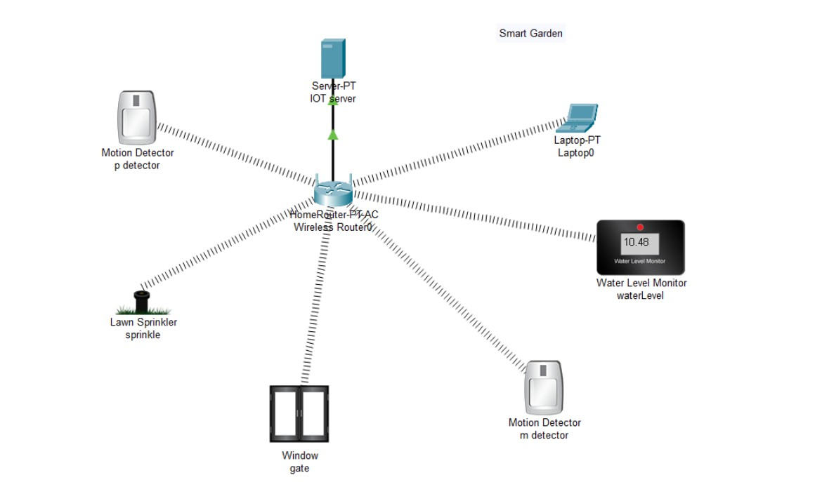
DESIGN WITH MODULES DESCRIPTION
Smart Garden System

Slide 7
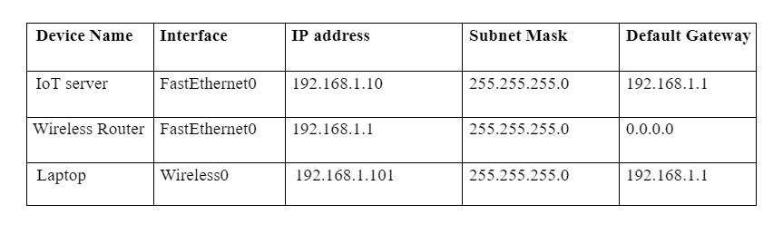
CALCULATIONS AND IMPLEMENTATION

Slide 8
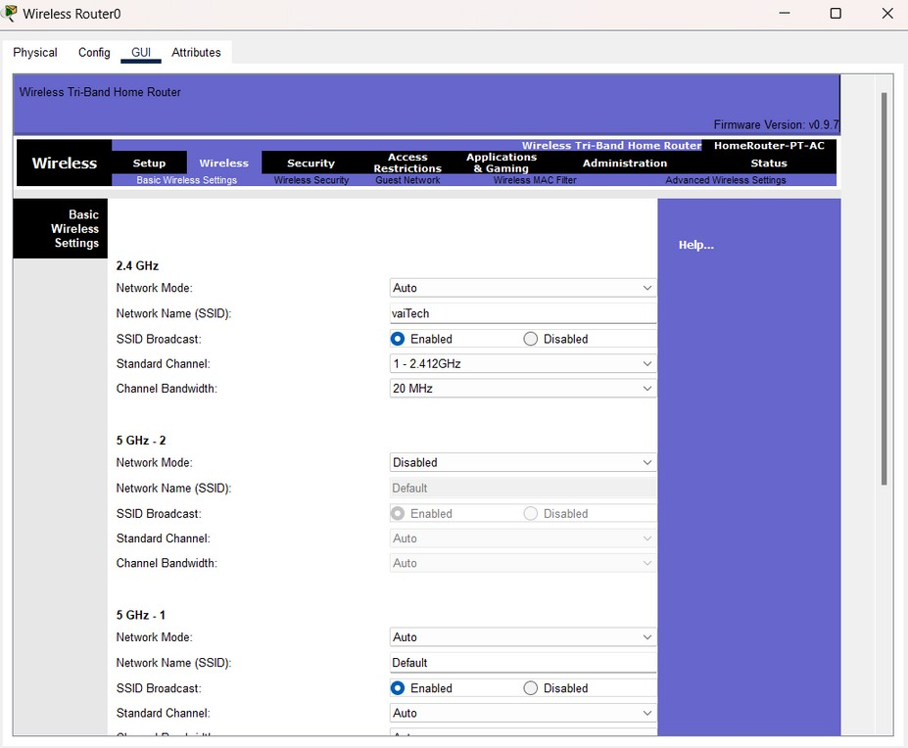
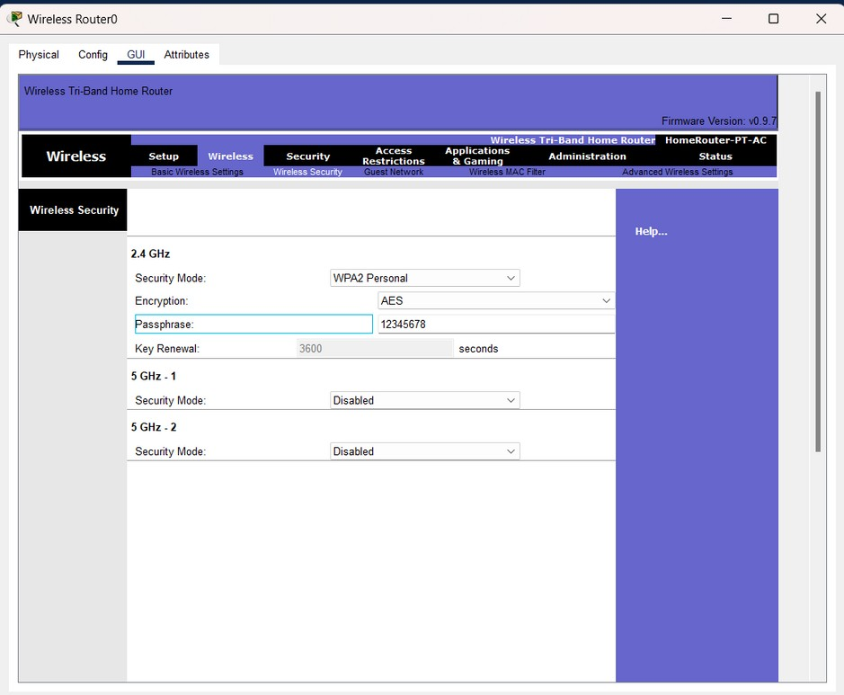

CALCULATIONS AND IMPLEMENTATION

Slide 9

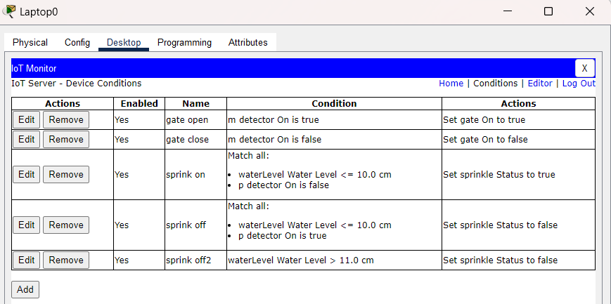


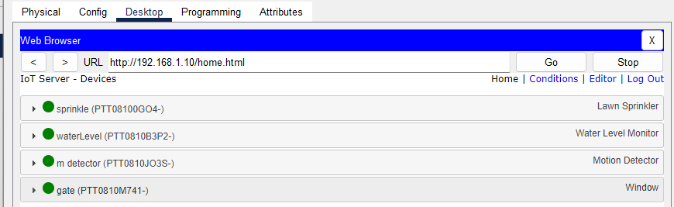
CALCULATIONS AND IMPLEMENTATION

Slide 10
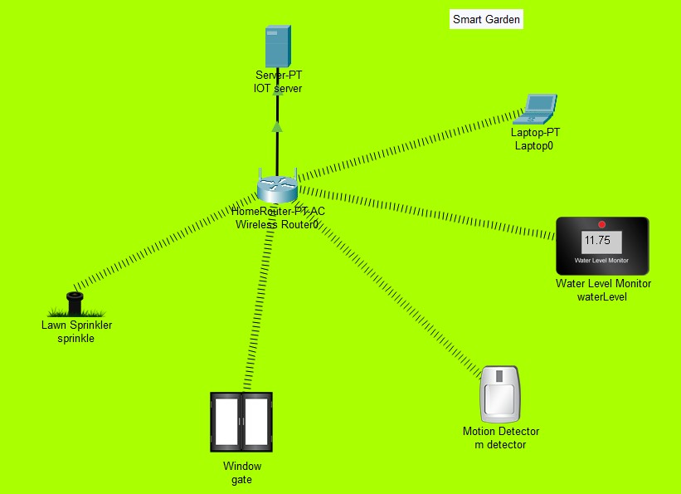
Implementation

Slide 11





INFERENCE
In conclusion, the Smart Garden System project is an innovative technology that combines automation, data analysis, and customization to improve gardening practices. The use of components such as sprinklers, water level monitors, sensors, and gates enables the system to monitor and respond to environmental factors in real-time, resulting in efficient use of resources and better plant growth.
The system promotes sustainable and environmentally friendly gardening practices by reducing waste and conserving water.
Additionally, the application provides gardeners in deciding and preventing overwatering or underwatering.
The project has the potential to revolutionize the way we garden, and as technology continues to advance, we can expect even more exciting developments in this area.

Slide 12




RESULT
Thus, IoT-based smart garden system was successfully designed and implemented in Cisco Packet Tracer.

